Slide 1
Causes & mechanism of action
The European Commission's support for the production of this publication does not constitute an endorsement of the contents, which reflect the views only of the authors, and the Commission cannot be held responsible for any use which may be made of the information contained therein.

Slide 2
Units
Unit 1: Definition, types and forms of violence and discrimination
Unit 2: Basics of the diversity dimension as causes of discrimination
Unit 3: Risk groups and vulnerable situations for occupational violence
Unit 4: Micro-, meso- and macro level in organizations as causes for occupational violence & Cultural imprints in the working context. Specifics of intercultural teams

Slide 3
Learning Outcomes
Be able to differentiate between the different types and forms of occupational violence and discrimination.
Be able to take into account the diversity dimensions in order to promote intercultural competences among the staff and minimize the risk of discrimination.
Be able to reflect upon his/her own cultural imprints
https://www.weedout.eu/

Slide 4
Definition, types & forms of violence and descrimination
Topic 1

Slide 5
Topic 1: Definition, types & forms of violence and discrimination
Definition of Occupational Violence
‘Incidents where staff are abused, threatened or assaulted in circumstances related to their work, including commuting to and from work, involving an explicit or implicit challenge to their safety, well-being and health’ (European Agency for Safety and Health at Work, 2010).
https://www.weedout.eu/

Slide 6
Topic 1: Definition, types & forms of violence and discrimination
Types of Violence
Violence through third parties (client-on-worker violence)
Worker-on-worker
Criminal intent
Personal relationship
https://www.weedout.eu/

Slide 7
Topic 1: Definition, types & forms of violence and discrimination
Forms of Violence
Psychological violence
Physiological/physical violence
Sexual violence
Discrimination
https://www.weedout.eu/

Slide 8
Basics of the diversity dimension as causes of discrimination
Topic 2

Slide 9
Topic 2: Basics of the diversity dimension as causes of discrimination
Definition of Discrimination
The unequal treatment of a person or a group based on personal characteristics such as sex, race, colour, national or social origin, religion, language or opinion.
https://www.weedout.eu/

Slide 10
Topic 2: Basics of the diversity dimension as causes of discrimination
Types and forms of Discrimination
Direct discrimination
Indirect discrimination
Harassment
Victimisation
https://www.weedout.eu/

Slide 11
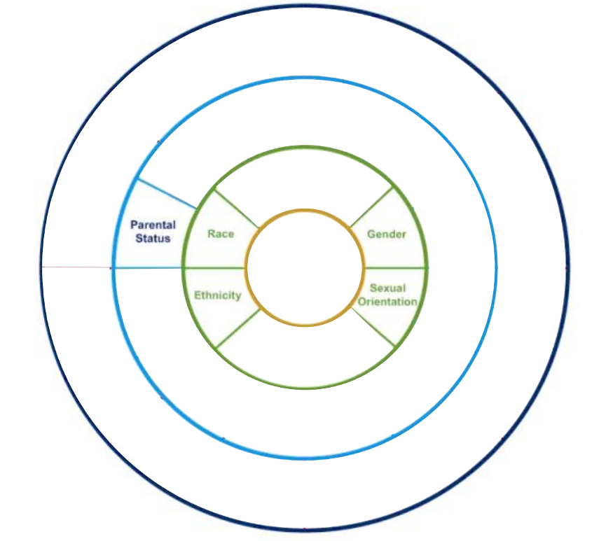
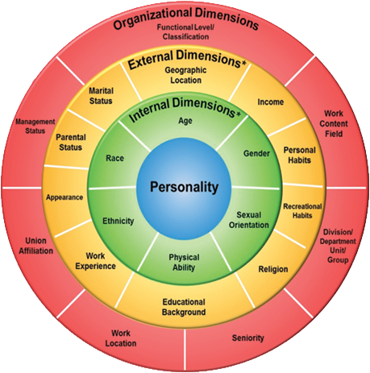
Inclusion is critical to business
Managed well, diversity provides benefits that increase success
Currently, an intersectionality is viewed as pertaining only to this subset of attributes.
The FOUR LAYERS OF DIVERSITY model created by Gardenswartz and Rowe has influenced and broadened
the conversation about diversity. It sets the tone for inclusion by reflecting each person’s reality in the organization

Slide 12
The Four Layers of Diversity Model
How do we manage it to reap its potential benefits?
At its core, diversity is about inclusion and exclusion.
The Four Layers of Diversity is used to frame the issue and encourage discussion and involvement in managing diversity.
The multiple dimensions of diversity are depicted in four concentric circles.
All these aspects represent areas in which there may be similarity and common ground as well as differences.
When well managed, these differences have the potential to bring new perspectives, ideas, and viewpoints needed by the organization.
If mismanaged, they can sow the seeds of conflict and misunderstanding that sabotage teamwork and productivity and hinder effectiveness.
To maximize the ability to manage this complex set of differences, organizations need to have a framework and strategy.

Slide 13
The Four Layers of Diversity Model
For an organization to get its arms around the complexity of diversity culture change, it needs to focus on three arenas:
(1) individual attitudes and behaviors,
(2) managerial skills and practices, and
(3) organizational values and policies.
To make culture change happen, the following seven-step process is suggested. The steps often may be going on at the same time.
STEP 1: GENERATING EXECUTIVE COMMITMENT
STEP II: ASSESSMENT
STEP III: DIVERSITY COUNCIL
STEP IV: SYSTEMS CHANGES
STEP V: TRAINING
STEP VI: MEASUREMENT AND EVALUATION
STEP VII: INTEGRATION

Slide 14
Topic 2: Basics of the diversity dimension as causes of discrimination
The dimensions of diversity include:
Gender | Age
Religious beliefs | Physical and mental ability
Race | Income
Martial status | Sexual orientation
Ethnicity | Occupation
Parental status | Language
Geographic location | and many more component
https://www.weedout.eu/

Slide 15
Topic 2: Basics of the diversity dimension as causes of discrimination
Protected characteristics by law:
Age
Race
Sex
Gender reassignment
Disability
Pregnancy and maternity
Marriage and civil partnership
Religion or belief
Sexual Orientation
Notes:
Include source
Mention if it’s National, EU etc.

Slide 16
Risk groups and vulnerable situations for occupational violence
Topic 3

Slide 17
Topic 3: Risk groups and vulnerable situations for occupational violence
Vulnerable groups of workers:
Women
Part-time works
Young workers and transient labour
Immigrants and ethnic minorities

Slide 18
Topic 3: Risk groups and vulnerable situations for occupational violence
Vulnerable situations:
Long shifts, irregular and unusual working hours
Income insecurity
Informal economy
Catering for nightlife customers
Stress and pressure
Lack of control at work
Burnout
Work location being in a high-crime area

Slide 19
Micro-, meso- and macro level in organizations as causes for occupational violence & Cultural imprints in the working context; Specifics of intercultural teams
Topic 4
1

Slide 20
Topic 4: Micro-, meso- and macro level in organizations as causes for occupational violence & Cultural imprints in the working context; Specifics of intercultural teams
Environmental factors are often limited to organizational environmental factors, such as cultures
Socioeconomic status (ex. poverty, unemployed, etc.) have frequently been associated with violent crime
One stressor that has been shown to be correlated with workplace aggression is social change (which usually involves political matters)

Slide 21
In-class exercise:
(20 minutes)
Based on this unit’s material, in groups of 3, write down all the types of discrimination and the characteristics protected by law.

Slide 22
References:
Argrusa, J. F., Coats, W., Tanner, J., and Leong, J. S. L. L. (2002): Hong Kong and New Orleans: A comparative study of perceptions of restaurant employees on sexual harassment. International Journal of Hospitality and Tourism Administration, 3, 3, 19-31
Argrusa, J. F., Coats, W., Tanner, J., and Leong, J. S. L. L. (2002): Hong Kong and New Orleans: A comparative study of perceptions of restaurant employees on sexual harassment. International Journal of Hospitality and Tourism Administration, 3, 3, 19-31
Baron, R. A., & Neuman, J. H. (1996). Workplace violence and workplace aggression: Evidence on their relative frequency and potential causes. Aggressive Behavior: Official Journal of the International Society for Research on Aggression, 22(3), 161-173.
Di Martino, V., Hoel, H., and Cooper, C. L. (2003): Violence and harassment in the workplace: A review of the literature. European Foundation for the Improvement of Living and Working Conditions: Dublin
Hoel, H. (1993): The question of union democracy in the Norwegian hotel and catering industry. Unpublished MSc thesis, University of Salford, United Kingdom Hoel, H. (2002): Bullying at work in Great Britain. Unpublished doctoral di
Hoel, H. (1993): The question of union democracy in the Norwegian hotel and catering industry. Unpublished MSc thesis, University of Salford, United Kingdom
Hotel and Caterer (1995): Letter from Neil Savage, 12 October, pp. 40-42

Slide 23
https://springinstitute.org/whats-difference-multicultural-intercultural-cross-cultural-communication/
https://www.hrsolutions-uk.com/4-types-of-discrimination/
https://www.ilo.org/wcmsp5/groups/public/---ed_dialogue/---sector/documents/publication/wcms_161998.pdf
https://www.nabet.us/proceedings-archive/NABET-Proceedings-2018.pdf#page=121
https://www.personio.com/hr-lexicon/types-of-discrimination/#1
Jackson, S. E. (1992). “Team composition in organizational settings: Issues in managing an increasingly diverse work force” in Group process and productivity. Eds. S. Worchel, W. Wood, and J. A. Simpson (Newbury Park, CA: Sage), 136-180.
Karasek, (1979): Job demands, job decision latitude and mental strain: implications for job redesign. Administrative Science Quarterly, 24, 285-330
Lankford, A. (2013). A comparative analysis of suicide terrorists and rampage, workplace, and school shooters in the United States from 1990 to 2010. Homicide Studies, 17(3), 255-274.
Peterson, R. D., Krivo, L. J., & Harris, M. A. (2000). Disadvantage and neighborhood violent crime: Do local institutions matter? Journal of Research In Crime And Delinquency, 37(1), 31-63.
University, U.S. (2016) Understanding the dimensions of diversity, USU. Available at: https://extension.usu.edu/employee/diversity/dimensions-of-diversity

Slide 24
Zagenczyk, T. J., Murrell, A. J., & Gibney, R. (2008). Effects of the physical work environment on the creation of individual-and group-level social capital. International Journal of Organizational Analysis, 15(2), 119-135.
Zohar, D. (1994): Analysis of job stress profile in the hotel industry. International Journal of Hospitality Management, 13, (3), 219-231

Slide 25
Project partners
DEKAPLUS
Cyprus
Czech University of Life Sciences Prague Czech Republic
DIAS Greece
OUT LOUD
Latvia
Social Innovation Fund Lithuania
Pancyprian Association of Hotel Managers Cyprus
Beneke & Prinzhorn GmbH Germany
https://www.weedout.eu/

