Slide 1
Dzimumu līdztiesības un starpkulturālās vides apsvērumi vardarbības darbavietā izpratnei (1)
Eiropas Komisijas atbalsts šīs publikācijas sagatavošanai nav uzskatāms par satura apstiprinājumu, kas atspoguļo tikai autoru viedokļus, un Komisija nevar būt atbildīga par tajā ietvertās informācijas jebkādu izmantošanu.

Slide 2
Tēmas
Darba tirgus vēsture un attīstība un tā saistība ar dzimumu nevienlīdzību darbavietā. (1.NODAĻA)
Dzimumu specifiskās iezīmes darba kontekstā vadības līmenī (2.NODAĻA)
Mikro- un varas politika organizācijās (3.NODAĻA)
Stereotipu, aizspriedumu un klišeju definīcija un diferencēšana (4.NODAĻA)

Slide 3
Mācību rezultāti
1. Viņš/viņa spēj atšķirt stereotipus, aizspriedumus un klišejas.
2. Viņš/viņa spēj identificēt dzimumu specifiskās iezīmes darba kontekstā, jo īpaši vadības līmenī.
3. Viņš/viņa spēj tikt galā ar mikro- un varas politisko dinamiku organizācijā

Slide 4
General overview
1.nodaļa
1st Module consists of 2 Units
Unit 1: History of the labour market and gender inequalities in the workplace
The history of the development of the labor market, its definitions, the gradual involvement and participation of women in the labor market are reviewed.
Unit 2: Gender-specific characteristics at management level, micro- and power political dynamics in the organization
1. Darba tirgus vēsture un attīstība un tā saistība ar dzimumu nevienlīdzību darbavietā
Attīstība, definīcijas, politika

Slide 5
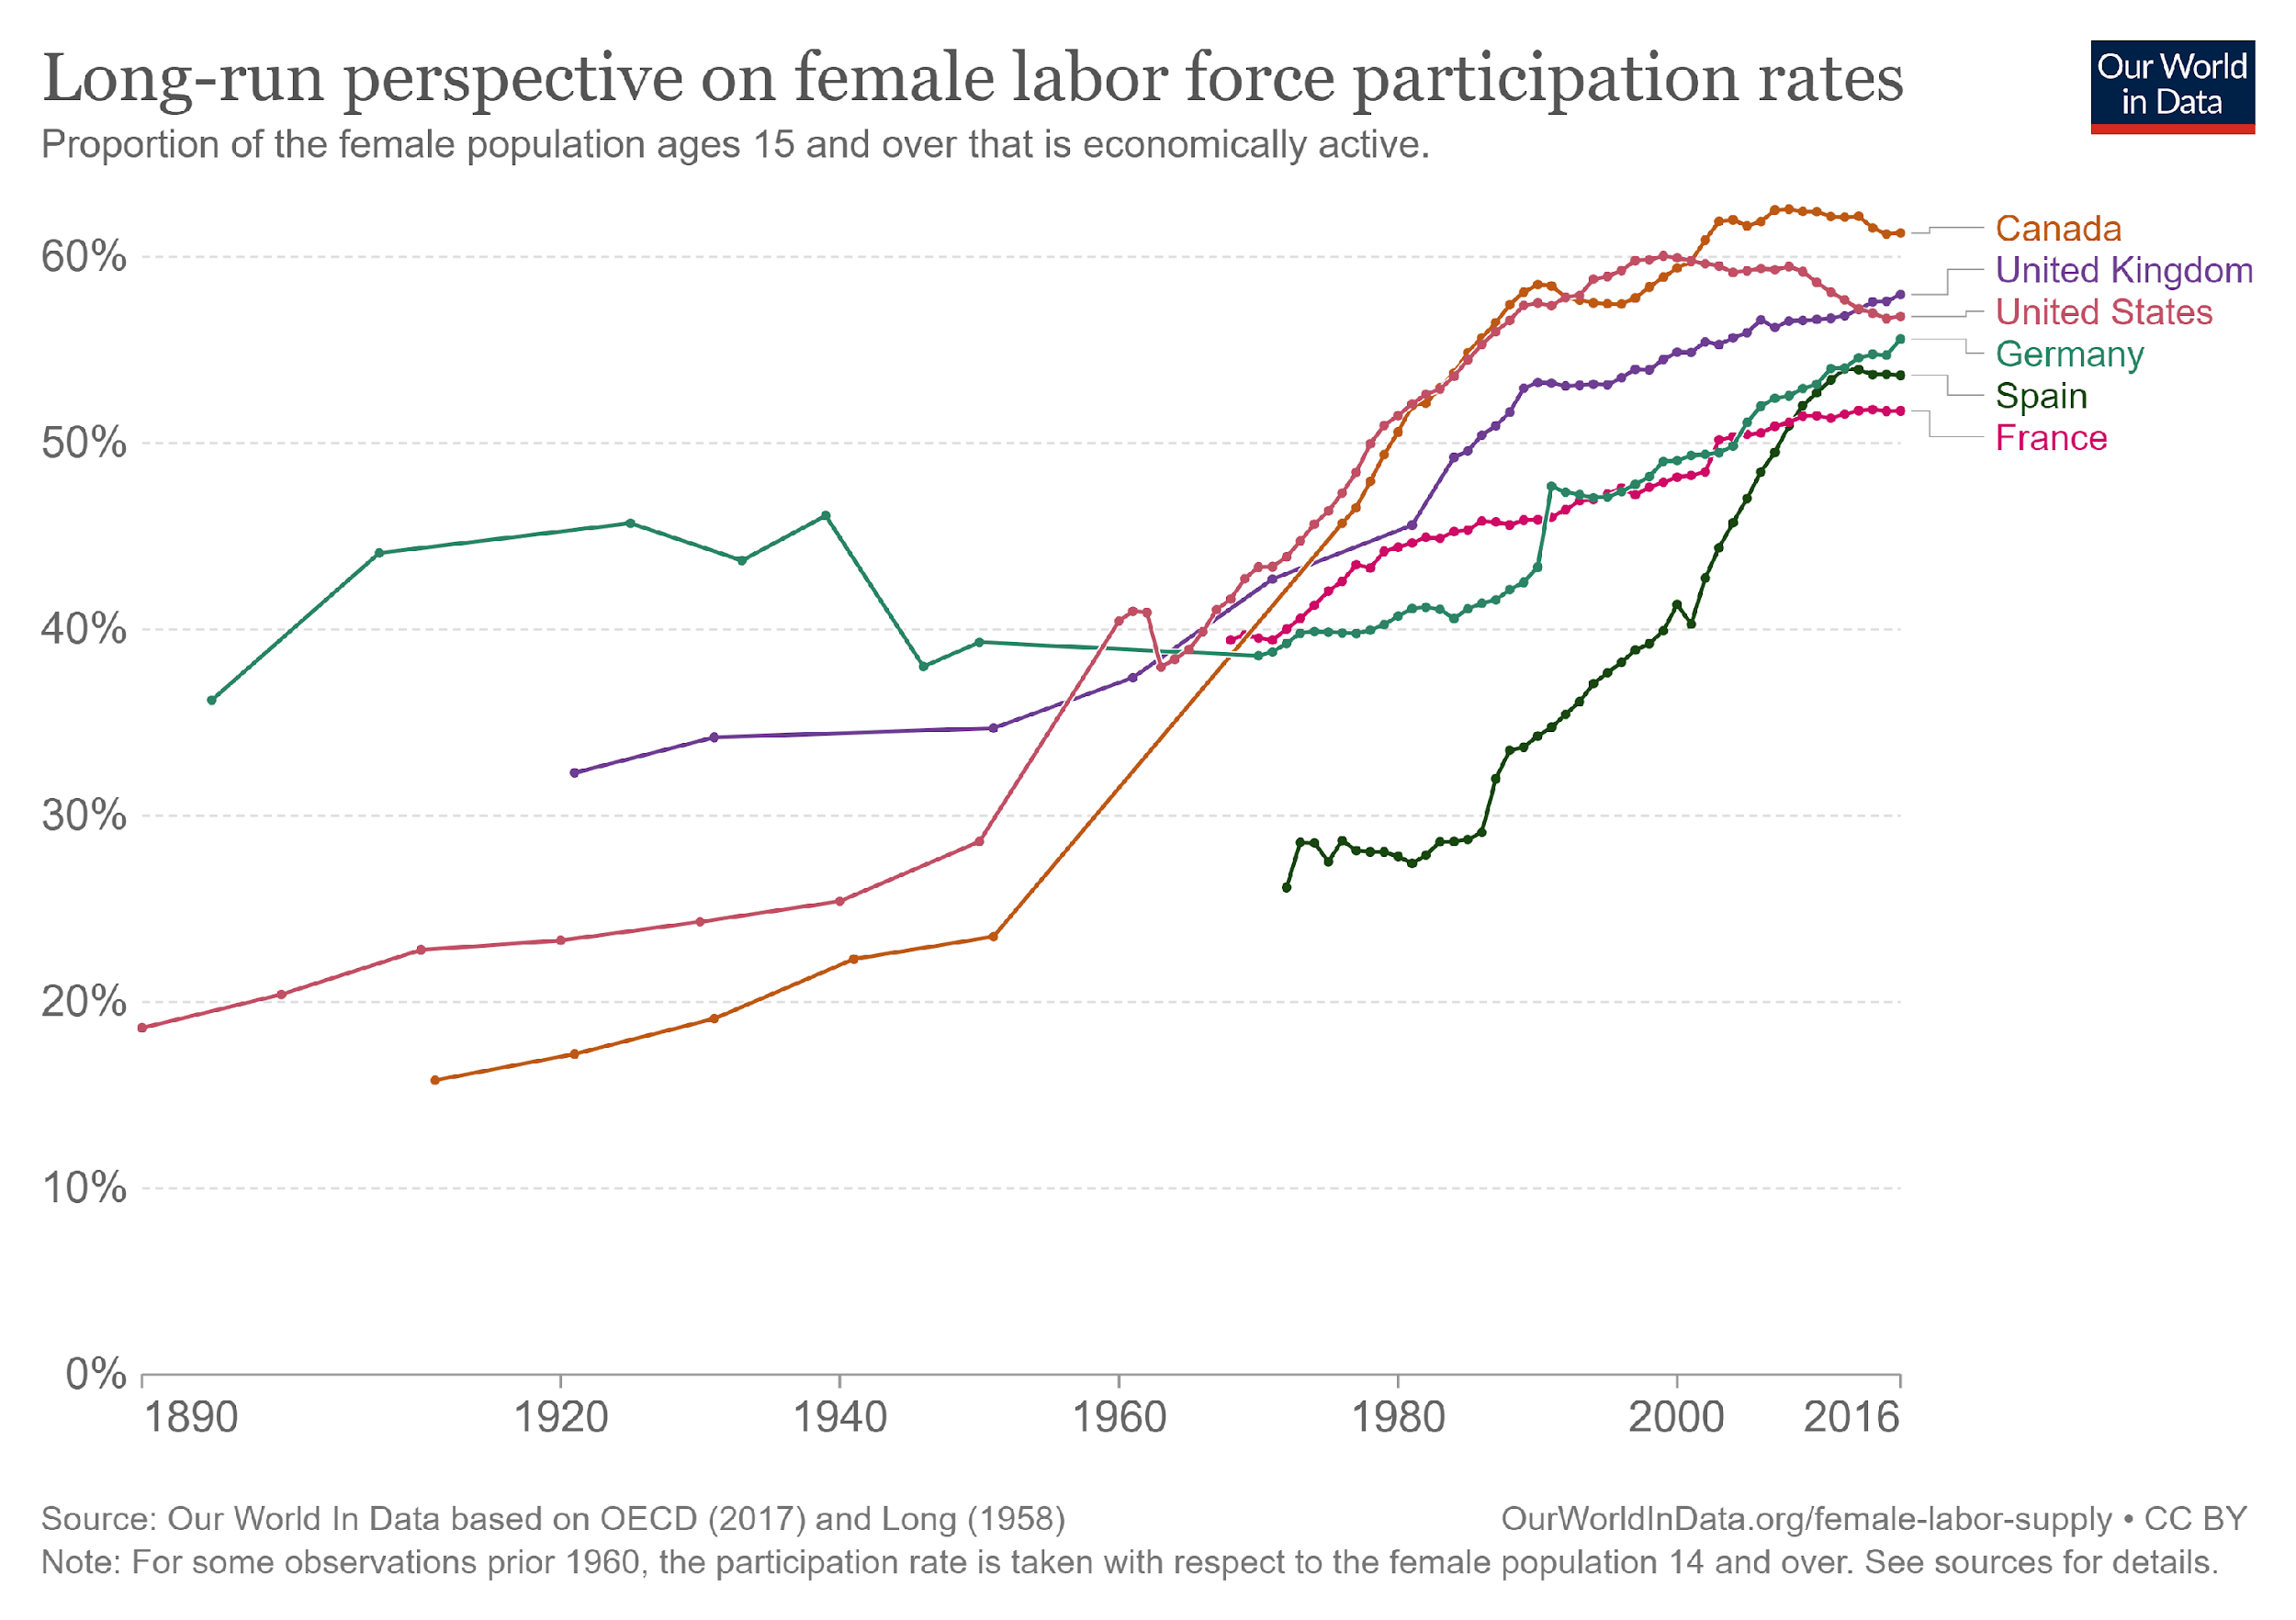
20. gadsimtā sieviešu līdzdalība darba tirgū ievērojami pieauga.
https://www.weedout.eu/
Notes:
Esteban Ortiz-Ospina, Sandra Tzvetkova and Max Roser (2018), Women’s employment. https://ourworldindata.org/female-labor-supply#labor-force-participation

Slide 6
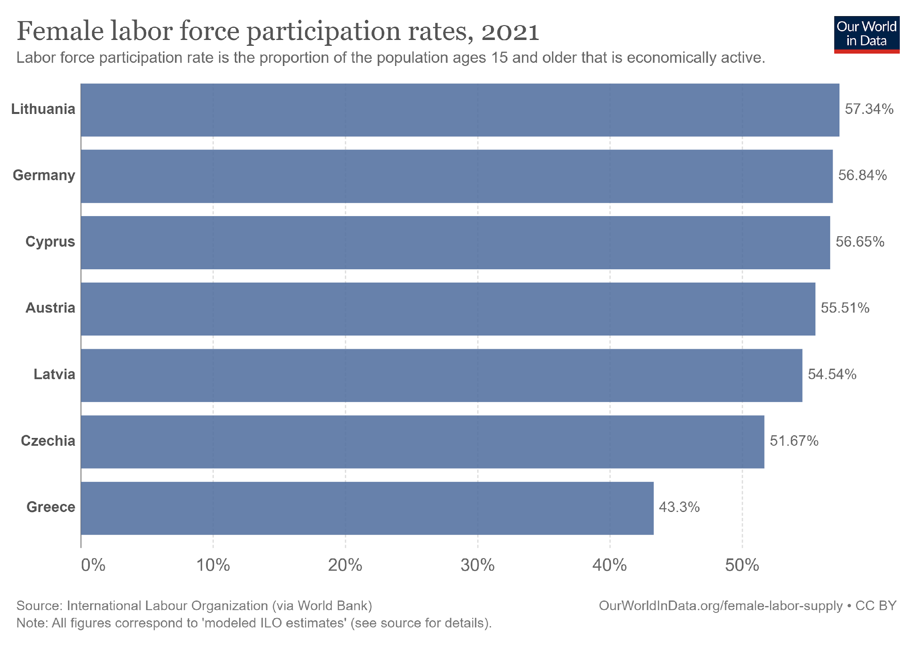

Slide 7
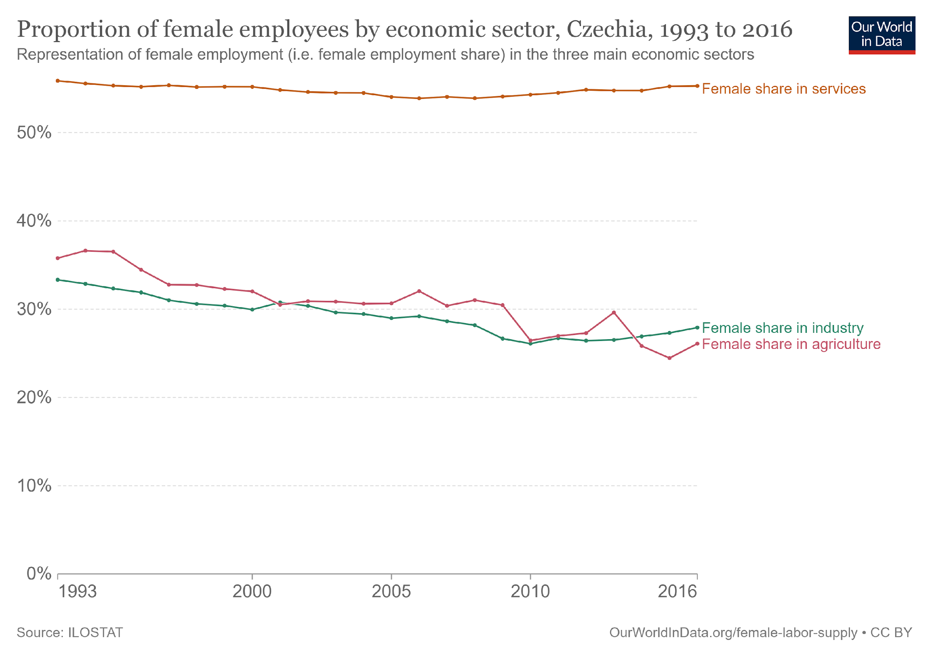
Sieviešu nodarbinātība dažādās tautsaimniecības nozarēs
Lielākajā daļā valstu pastāv "profesionālā segregācija":
Sievietēm ir raksturīga neproporcionāla koncentrācija atsevišķās profesijās.
Sievietēm ir dominējoša vieta HORECA un tūrismā
Kopumā ekonomikā 46,1 % darbinieku ir sievietes.
Viesmīlības nozarē šis rādītājs ir 53,7 %.
Notes:
Women have dominate place in hotels, catering, and tourism for quite some time now. In the overall economy, 46.1% of employees are women, but in the hospitality sector this figure has grown to 53.7%.

Slide 8
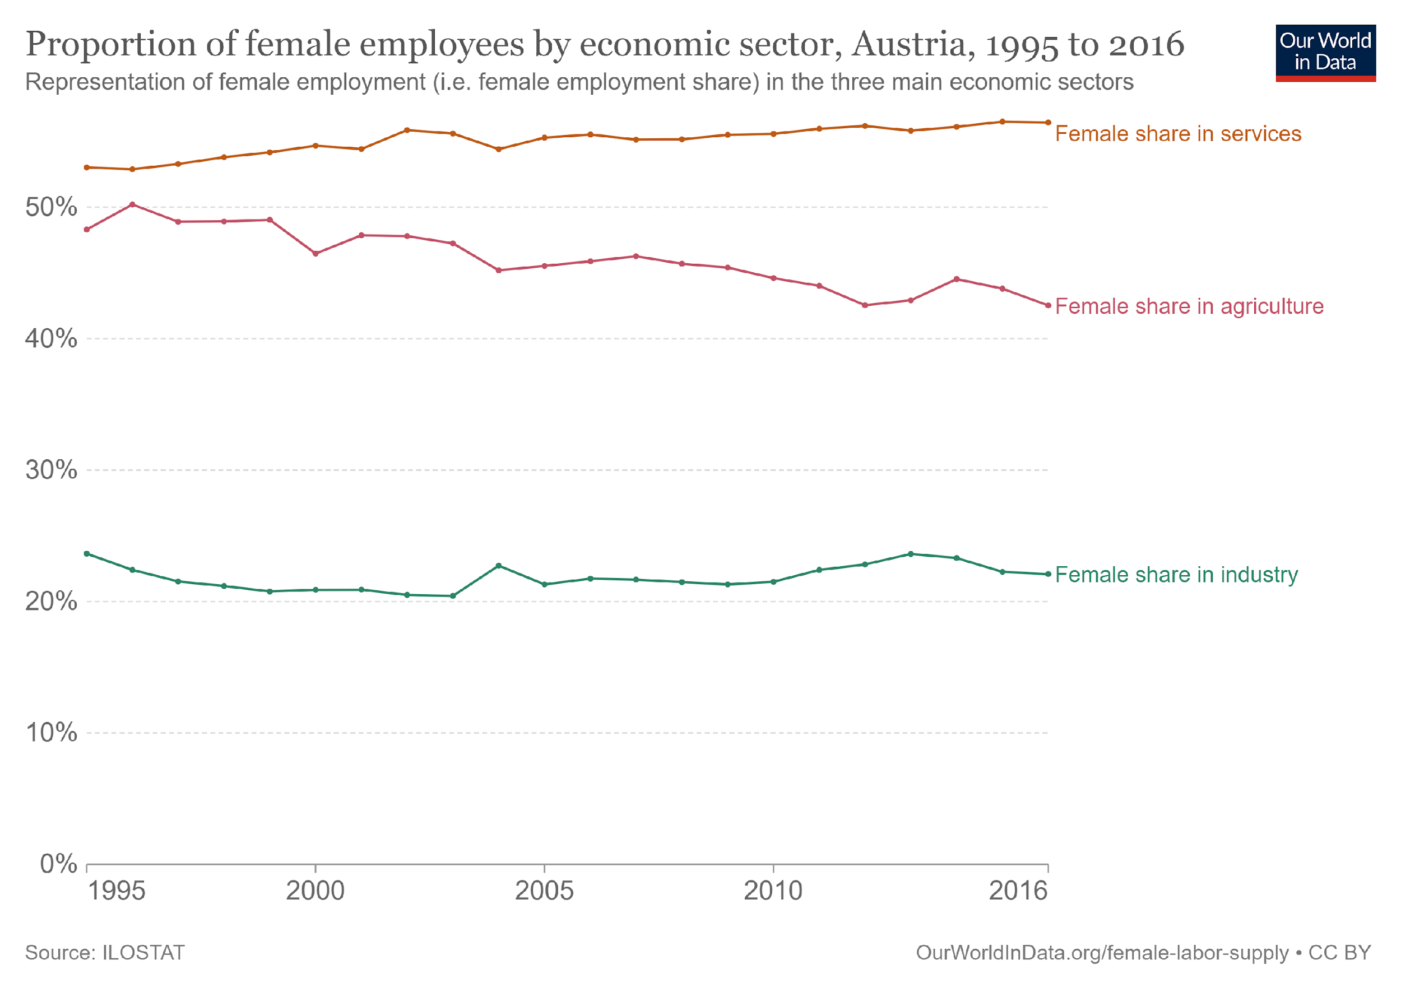
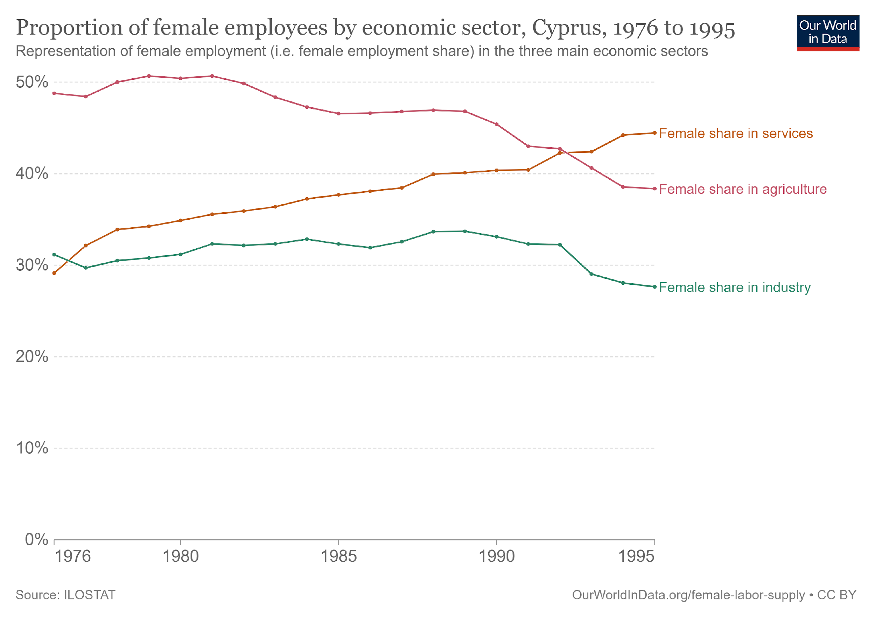
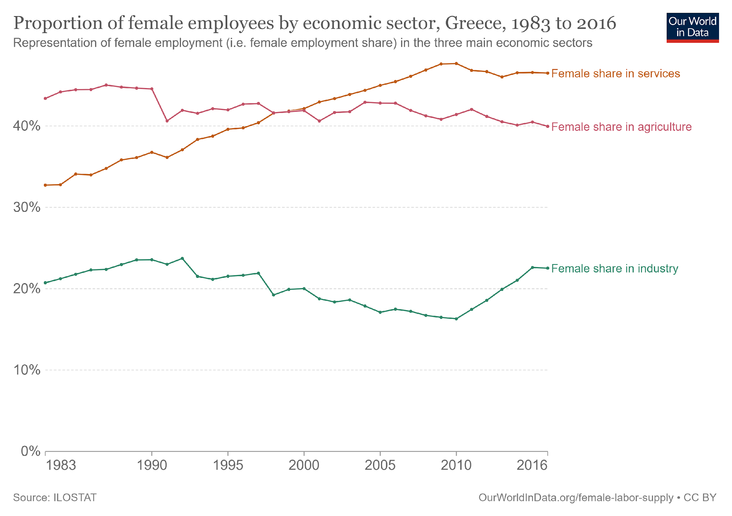

Slide 9
Tūrisma nevienlīdzīgā ekonomika
Sievietes veido pusi no visiem viesnīcu un restorānu nozarē strādājošajiem. (Global Report on Women in Tourism, 2011).
Dzimumu stereotipu un diskriminācijas dēļ lielākā daļa šo sieviešu strādā zema statusa, slikti apmaksātus un nestabilus darbus, no kuriem daudzi ir sezonāli.
Sievietes reti ieņem vadošus vai profesionālus amatus, un, ja tās tos ieņem, parasti viņām maksā mazāk nekā vīriešiem.
Daudzas no viesnīcu nozarē nedrošās darbavietās strādājošajām sievietēm ir imigrantes vai migrantes un/vai pārstāv minoritātes. Šādu profesiju feminizācija un rasizācija mēdz izraisīt turpmāku algu līmeņa, darba drošības un sociālās vērtības samazināšanos.
Seksuālās uzmākšanās līmenis ir visaugstākais no visām nozarēm, un visbiežāk vainīgie ir klienti, darba vadītāji vai kolēģi.
Notes:
Tourism is the largest and fastest-growing economic sector in the world. In many countries, tourism acts as an engine for development by earning foreign exchange and creating jobs. In 2016, international tourist arrivals reached more than 1.2 billion — a new record — and the numbers are expected to grow by three to four per cent annually.ii Travel and tourism accounts for 10.2 per cent of global GDP (US$7.6 trillion) and employs 292 million people, equivalent to one in ten jobs worldwide.iii According to the Global Report on Women in Tourism (2011), women make up half of all employees in the hotel and restaurant industry. Because of gender stereotyping and discrimination, the vast majority of these women work in low status, poorly-paid and precarious jobs, many of which are seasonal. Women rarely reach managerial or professional positions, and when they do, they are usually paid less than men. In addition, many of the women in the hotel industry’s insecure jobs are immigrants or migrants, and/or women of visible minorities. The feminization and racialization of such occupations tend to trigger a further decline in wage rates, job security and social value. Housekeeping is no exception. The hotel industry relies heavily on immigrant, minority and migrant women to do the back-of-house jobs. The titles ‘maid’ or ‘chambermaid’— underscored by the slogan a home away from home — indicate that housekeeping is considered women’s domestic work, and therefore not skilled labour. It is considered dirty and stigmatized through association with personal servitude. Housekeepers are expected to be invisible, going about their work without disturbing guests. All the housekeepers interviewed for this study complained that they are viewed as subservient and undervalued, which helps explain why few of them can move into front-of-house jobs.

Slide 10
Ar dzimumu saistītas vardarbības un uzmākšanās novēršana viesnīcu, ēdināšanas un tūrisma nozarē (HORECA)
Vardarbība un uzmākšanās apdraud vienlīdzīgas iespējas, ir nepieņemama un nav savienojama ar pienācīgu darbu. (ILO, Konvencija par vardarbību un uzmākšanos (No. 190), 2019)
Vardarbība un uzmākšanās ir vēršanās pret:
Personas cieņu;
Tiesībam uz vienlīdzīgu un nediskriminējošu attieksmi;
Personas veselību.
Dzimumu nevienlīdzības mazināšana - uzmākšanās mazināšana Atšķirību starp dzimumiem mazināšana - tādējādi mainot sabiedrībā iesakņojušās struktūras - samazina vardarbības un uzmākšanās draudus vai risku darba vietā. Tas ietver:
* panākt vienlīdzīgu atalgojumu; * laba bērna kopšanas atvaļinājuma sistēma., * vispārēja valsts bērnu aprūpe.
Darba ņēmēji, kurus tas skar, jūtas nedroši
Notes:
https://www.ohchr.org/en/stories/2019/07/new-labour-convention-tackle-violence-against-women-work
Violence and harassment are attacks on personal dignity, the right to equal and non-discriminatory treatment and often a person’s health. Workers affected by it feel insecure about their work; they are more frequently absent and may even be unable to work, with consequent impacts on productivity and corporate and public costs. Some national-level surveys point to a long-standing increase in reported violence and harassment. Certain European countries, such as the Scandinavian countries, have more coordinated, established policies on preventing and tackling violence and harassment. Awareness of the topic at the national level, its inclusion in legislation and the degree of the social partners’ involvement in policies and interventions all contribute to the effectiveness of policies to address it.
https://www.eurofound.europa.eu/publications/report/2015/violence-and-harassment-in-european-workplaces-extent-impacts-and-policies

Slide 11
Visbiežāk sastopamie vardarbības veidi darbā, ar kuriem saskaras sievietes:
Seksuāla uzmākšanās
74 % - 75 % sieviešu kādreiz savā dzīvē ar to ir saskārušās (Eiropas Savienības Pamattiesību aģentūras (FRA) 2014. gadā veikts pētījums)
Quid pro quo - darbinieks saskaras ar spiedienu iesaistīties seksuālās darbībās apmaiņā pret priviliģētu attieksmi - paaugstinājumu amatā, darba vietas saglabāšanu vai citām darbinieku priekšrocībām
Naidīga darba vide - seksuāla rakstura uzmākšanās, joki vai komentāri, kas liek darbiniekam justies iebiedētam vai apdraudētam; atsevišķi izvarošanas vai seksuāla uzbrukuma gadījumi
Atalgojuma atšķirība– 23% visa pasaulē (International Labor Organization, ILO);
Uzmākšanās grūtniecības laikā– notiek tad, ja sievietei liek justies neērti saistībā ar grūtniecību;
Psiholoģiska vardarbība.
Vardarbība darbavietā ir realitāte, ar kuru pastāvīgi saskaras miljoniem sieviešu visā pasaulē.
Noskatieties VIDEO, 2.53 minūte - līdz beigām
Notes:
Sexual Harassment Training Trial https://etactics.com/blog/sexual-harassment-in-the-workplace-statistics
Dianova – organization which consists of a variety of non-profit associations and foundations operating in Africa, the Americas, Asia, and Europe, and dedicated to social change.
A Silent “Colleague”: Violence against Women in the Workplace
https://www.dianova.org/news/a-silent-colleague-violence-against-women-in-the-workplace/
What Are the Most Common Types of Sexual Harassment in the Workplace?
There are two main categories of workplace sexual harassment:
Quid pro quo. Quid pro quo is a form of sexual harassment where an employee faces pressure to engage in sexual activity in exchange for preferential treatment. This preferential treatment generally involves promotions, job retention or other employee benefits.
Hostile work environment. A hostile work environment is created when a harasser’s conduct negatively impact the victim’s work environment. This includes making repeated sexual advances, jokes or comments that cause an employee to feel intimidated or threatened. It also includes isolated incidences such as rape or sexual assault.

Slide 12
Seksuālā uzmākšanās formas
Nevēlami seksuāli piedāvājumi
Seksuālu pakalpojumu pieprasīšana
Mutiska vai fiziska seksuāla rakstura uzmākšanās
Aizskarošas piezīmes par personas dzimumu.
Notes:
Etactics (2021). 70+ Sexual Harassment in the Workplace Statistics
https://etactics.com/blog/sexual-harassment-in-the-workplace-statistics#General-Information

Slide 13
Notes:
https://etactics.com/blog/sexual-harassment-in-the-workplace-statistics

Slide 14
5 pasākumi seksuālās uzmākšanās apkarošanai uzņēmumā
1. Vadības iesaistīšana
Izpilddirektors un valde demonstrē, ka uzņēmums neievēro nekādu toleranci pret uzmākšanos.
Sodi par uzmākšanos tiek piemēroti vienādi visā organizācijā neatkarīgi no darbinieka statusa.
Informējiet darbiniekus par konfidenciāliem ziņošanas kanāliem, pa kuriem viņi var ziņot par seksuālās uzmākšanās gadījumiem, un nodrošināt šādu kanālu pieejamību.
Izstrādājiet politiku, kas vērsta pret uzmākšanos, un nodrošiniet, ka visi darbinieki tai piekrīt
Nosakiet visiem darbiniekiem obligātu apmācību par seksuālās uzmākšanās novēršanu
Negaidiet darbinieku ziņojumus, lai noskaidrotu problēmas apmērus jūsu uzņēmumā
Notes:
https://www.eqs.com/compliance-blog/sexual-harassment-workplace/
5 Measures You Can Take Against Sexual Harassment in the Company
Businesses also suffer if they are held liable. For example, employers in the UK can be liable for acts of sexual harassment committed by their employees. An employer will only have a defense if they can show they took reasonable steps to avoid harassment in the workplace.
1. Involve Management
The CEO and Board must demonstrate that the company has a zero-tolerance approach to harassment. They must make clear that punishment for harassment applies equally across the organization, regardless of employee status. The Board should regularly review key data on sexual harassment such as the number of incident reports and the average time it takes the company to resolve cases. They should formally approve the anti-harassment policy and be included in any training courses.
2. Ensure that employees know about and have access to confidential reporting channels through which they can report cases of sexual harassment
If this is not the case, look at implementing whistleblowing channels including a case management software and ensuring they are communicated. It’s worth noting that reporting channels can make it easier for those who feel unsafe to file a report. While this can make the investigation more challenging, 2-way communication with the anonymous whistleblower can help build up trust which may result in the disclosure of more information.
3. Have an anti-harassment policy and ensure all employees sign up to it
Important aspects of the policy:
Clearly define the meaning of sexual harassment. In Germany, for example, the wording might be taken from the General Equal Treatment Act which includes as sexual harassment, for example, unwanted touching, salacious remarks or jokes, sexual gestures or the showing of pornographic images.
Using examples and case studies can help explain the meaning where it could be open to interpretation.
Encourage employees to report harassment. Therefore, the policy should include information on relevant reporting channels.
Present the procedures for investigating complaints and formal/informal resolution processes.
Specify the disciplinary sanctions that will apply when harassment has occurred (including dismissal where appropriate).
4. Make training on preventing sexual harassment mandatory for all employees
Education not only helps to safeguard against inappropriate behavior and unwanted advances by clearly defining violations, but it also empowers those who may encounter sexual harassment to recognize and report these cases. Training builds community in a workplace, with everyone working towards a common goal, and a feeling of safety. Training content should also include bystander training which teaches employees what to do if they observe sexual harassment happening to someone else.
5. Don’t wait for employee reports to find out the extent of the problem in your company
Be proactive and add questions in your annual employee engagement survey to find out whether staff have ever been victims of harassment or have seen it happening to someone else. If they have, find out if they ever reported it and if not, why not. This allows you to determine the effectiveness of your company’s reporting program.

Slide 15
Atalgojuma atšķirība starp dzimumiem Atalgojuma atšķirība starp dzimumiem ES
Dzimumu darba samaksas atšķirība ir sieviešu un vīriešu vidējās bruto stundas izpeļņas starpība.
2020. gadā vīriešu un sieviešu darba samaksas atšķirība ES-27 bija 13,0 %, un kopš 2010. gada tā ir samazinājusies tikai par 2,8 procentpunktiem.
2019. gadā sievietes ES vidēji nopelnīja par 14,1 % mazāk stundā nekā vīrieši (ES27 dati). Tomēr starp ES valstīm pastāv lielas atšķirības.
Sievietēm ar bērniem, sievietēm ar citu ādas krāsu, sievietēm bēgļiem un migrantēm, kā arī sievietēm ar invaliditāti šis rādītājs ir vēl zemāks.
https://ec.europa.eu
Notes:
Globally, despite decades of activism, and dozens of laws on equal pay, women still earn less than 80 cents for every dollar men do.
European Parliament news (2022). Understanding the gender pay gap: definition and causes
https://www.europarl.europa.eu/news/en/headlines/society/20200109STO69925/understanding-the-gender-pay-gap-definition-and-causes
https://ec.europa.eu/info/policies/justice-and-fundamental-rights/gender-equality/equal-pay/gender-pay-gap-situation-eu_en
What is the gender pay gap and how is it calculated?
The gender pay gap is the difference in average gross hourly earnings between women and men. It is based on salaries paid directly to employees before income tax and social security contributions are deducted. Only companies of ten or more employees are taken into account in the calculations. The EU average gender pay gap was 13.0% in 2020.
https://godigital.lmlo.lt/interactive_reading.html?m=2
What is Gender pay gap?
The gender pay gap is the difference in average gross hourly earnings between women and men. It is based on salaries paid directly to employees before income tax and social security contributions are deducted.
Working women in the EU earn on average 14% less per hour than men.
The reasons for gender pay gap are:
sectoral segregation (when women are overrepresented in low-paid jobs and men are overrepresented in better-paid jobs);
Unequal share of paid and unpaid work (women are more likely to work part-time because they need to take care of children when men are more likely to work full-time because they do not participate in household duties);
the glass ceiling (companies simply do not let women get top positions).
The difference in payment that men and women get for the same job also is one of the reasons, which influence to the gender pay gap.
Kodėl blogai?
Mažiau pensijos, ilgiau gyvena, vyresnės
Mažiau uždirbi, mažiau reikalauja,

Slide 16
Faktori, kas veicina atalgojuma atšķirību
Kā tiek vērtēts darbs
Segregācija
Stereotipi
Darba-privātās dzīves balanss
Sieviešu prasmes tiek novērtētas zemāk nekā vīriešu prasmes.
Sievietes un vīrieši joprojām mēdz strādāt dažādos amatos..
Sievietes bieži vien strādā zemāk novērtētos un zemāk atalgotos ekonomikas sektoros.
Vairāk sieviešu izmanto bērna kopšanas atvaļinājumu. Bērnu aprūpes iespēju trūkums nozīmē, ka sievietes bieži vien ir spiestas pamest darba tirgu.
Notes:
How work is valued
In some cases, women may earn less than men for doing jobs of equal value. The main cause is the way in which women's skills are valued compared to men's.
Segregation
Segregation in the labour market also reinforces the gender pay gap. Women and men still tend to work in different jobs.
Stereotypes
Segregation is frequently linked to stereotypes. While around 60% of new university graduates are women, they are a minority in fields like mathematics, computing and engineering. Consequently, fewer women work in scientific and technical jobs, while women often work in lower valued and lower paid sectors of the economy.
Work-life balance
Far more women than men choose to take parental leave. This, together with a lack of childcare facilities, means that women are often forced to leave the labour market. Only 65.8% of women with young children in the EU are working, compared with 89.1% of men. Across Europe around 32% of women work part-time, compared with only around 8% of men.
‹#›

Slide 17
Kāpēc ir svarīgi novērst vīriešu un sieviešu darba samaksas atšķirības.
Likvidēt uz dzimumu balstītu vardarbību un uzmākšanos darba vidē
https://www.youtube.com/watch?v=KjvtOIAtNsA 5 min., EPIC, Equal Pay International Coalition
2. EPIC: Kāpēc joprojām pastāv vīriešu un sieviešu darba samaksas atšķirības? https://www.youtube.com/watch?v=wa1El_VZ5q4
https://news.un.org/en/story/2022/09/1126901
3. FamUnDo – Inovatīvs projekts, lai uzņēmumos uzlabotu ģimenēm draudzīgu politiku
https://lpf.lt/family-learning.eu/?page=outcomes
Notes:
Global Wage Report 2018: The gender pay gap
https://www.ilo.org/global/about-the-ilo/multimedia/maps-and-charts/enhanced/WCMS_650829/lang--en/index.htm

Slide 18
Kā uzņēmumi var novērst seksuālu uzmākšanos darbavietā
Iepazīstieties ar 2018. gada Globālā algu ziņojuma datiem:
Salīdziniet un pārrunājiet datus par savu valsti un citu izvēlēto ES valsti.
https://www.ilo.org/global/about-the-ilo/multimedia/maps-and-charts/enhanced/WCMS_650829/lang--en/index.htm
Notes:
https://www.ilo.org/global/about-the-ilo/multimedia/maps-and-charts/enhanced/WCMS_650829/lang--en/index.htm
How Companies Can Prevent Sexual Harassment in the Workplace
https://www.eqs.com/compliance-blog/sexual-harassment-workplace/

Slide 19
Nesenie notikumi: Pagājušā gadsimta 70. gados tika sasniegti trīs pagrieziena punkti algota darba formā:
1 elastīgāki darba līgumu noteikumi un darba devēja un darbinieka savstarpējie pienākumi;
2 palielinoties sieviešu līdzdalībai algotā darbā, palielināta darba intensitāte mājsaimniecībā;
3 spēku līdzsvara maiņa darba tirgus institūcijās..
Šīs tendences ir visredzamākās mūsdienu Rietumeiropā ar tās izstrādāto sociālās likumdošanas sistēmu attiecībā uz varu darba tirgus institūcijās.
Notes:
Gender Equality Index https://eige.europa.eu/gender-equality-index/2022
EIGE (The European Institute for Gender Equality). Good practices combating gender-based violence.
https://eige.europa.eu/gender-based-violence/good-practices/spain/masters-course-gender-violence-improves-professional-practice labour market for 10 years or more.
The issue of gender in the labor market emerged at the beginning of the 20th century.
- In the early 20th century, most women in the United States and Europe did not work outside the home
those who did, were primarily young and unmarried.
- Women did enter the labor force in greater numbers by 1930, with participation rates reaching nearly 50 percent for single women and nearly 12 percent for married women.
- Between the 1930s and mid-1970s, women’s participation in the economy continued to rise.
- In the 1970s young women more commonly expected that they would spend a substantial portion of their lives in the labor force, and they prepared for it, increasing their educational attainment and taking courses and college majors that better equipped them for careers as opposed to just jobs.
‹#›

Slide 20
Ieteikumi profilaksei
1. VIESNĪCU INDUSTRIJA
Jāaizstāv darba tiesības un vienlīdzīga atalgojuma princips.
Nodrošināt, ka visiem darbiniekiem tiek maksāta alga, kas nodrošina iztikas minimumu, un viņi saņem pabalstus.
Aizsargāt darba ņēmēju tiesības apvienoties organizācijās un saukt korporācijas pie atbildības par darba tiesību pārkāpumiem.
Atbalstīt sieviešu tiesību organizācijas, kas strādā, lai izbeigtu vardarbību pret sievietēm.
Veicināt dzimumu līdztiesības plānu īstenošanu organizācijās.
2. VALDĪBAS
Var īstenot valsts politiku 4 galvenajās jomās, lai mainītu mājsaimnieku dzīvi.
Var kaut ko mainīt, izsakot savu viedokli un izvēloties uzņēmumus, kas pret saviem darbiniekiem izturas ar cieņu
3. PATĒRĒTĀJI
Notes:
Much can be done to address the economic insecurity and hazards women face working as hotel housekeepers.
1. THE HOTEL INDUSTRY must uphold labour rights and the principle of pay equity, and take tangible steps to improve the safety and overall working conditions of their employees
2. GOVERNMENTS can enact public policy in four key areas to make a lasting difference in the lives of housekeepers, and to reduce the yawning gap between rich and poor and between the working lives of men and women.
• Ensure that all workers are paid a living wage and receive benefits.
• Protect workers’ right to organize and hold corporations accountable for violations of labour rights
• Support women’s rights organizations working to end violence against women
3. CONSUMERS can make a difference by speaking out and choosing to spend their money at businesses that treat their workers with respect and dignity. When travelling, choose to stay in unionized hotels whenever possible and avoid hotels that are known to violate workers’ rights. Consult www.Fairhotel.org to learn more

Slide 21
Resursi:
Women and Tourism: Designing for Inclusion, World Bank, 2017. Report on how to integrate a gender lens into tourism development projects.
Tourism’s Dirty Secret: The Exploitation of Hotel Housekeepers, Oxfam Canada, 2017. Research report on the working lives of hotel housekeepers in Toronto (Canada), Punta Cana (Dominican Republic) and Phuket (Thailand), including sexual harassment and exploitation.
Know How Guide: Human Rights and the Hotel Industry, International Tourism Partnership, 2014. Guide for hotel companies on how to implement the United Nations Guiding Principles on Business and Human Rights.
To find out more, please see Addressing Gender-Based Violence and Harassment: Emerging Good Practice for the Private Sector.

Slide 22
Atsauces :
ILO, C190 - Violence and Harassment Convention, 2019 (No. 190) (https://www.ilo.org/dyn/normlex/en/f?p=NORMLEXPUB:12100:0::NO::P12100_ILO_CODE:C190)
Esteban Ortiz-Ospina, Sandra Tzvetkova and Max Roser (2018), Women’s employment. https://ourworldindata.org/female-labor-supply#labor-force-participation
Eurofound (European Foundation for the Improvement of Living and Working Conditions). Harassment and violence at work. (https://www.eurofound.europa.eu/observatories/eurwork/industrial-relations-dictionary/harassment-and-violence-at-work)
Eurofound. Violence and harassment in European workplaces: Extent, impacts and policies. (https://www.eurofound.europa.eu/publications/report/2015/violence-and-harassment-in-european-workplaces-extent-impacts-and-policies)
Restauranting through history (https://restaurant-ingthroughhistory.com/tag/immigrant-waitresses/)
Gender matters: Rethinking violence in tourism// in Annals of Tourism Research, Volume 88, May 2021, 103143 (https://www.sciencedirect.com/science/article/pii/S0160738321000050)
Eurofound (2022). Gender equality. https://www.eurofound.europa.eu/topic/gender-equality
UNESCO (2022). Gender equality: one step forward, two steps back// in Reshaping policies for creativity: addressing culture as a global public good, pages 241-261, illustrations (https://unesdoc.unesco.org/ark:/48223/pf0000380503)

Slide 23
Ausauces :
EurWORK/European Observatory of Working Life (2020). Harassment and violence at work
(https://www.eurofound.europa.eu/observatories/eurwork/industrial-relations-dictionary/harassment-and-violence-at-work)
Esteban Ortiz-Ospina, Sandra Tzvetkova and Max Roser (2018). Women’s employment//in Our World in Data (https://ourworldindata.org/female-labor-supply#labor-force-participation)
Dianova (2017). A Silent “Colleague”: Violence against Women in the Workplace
(https://www.dianova.org/news/a-silent-colleague-violence-against-women-in-the-workplace/)
European Parliament news (2022). Understanding the gender pay gap: definition and causes
(https://www.europarl.europa.eu/news/en/headlines/society/20200109STO69925/understanding-the-gender-pay-gap-definition-and-causes)
ILO. Global Wage Report 2018: The gender pay gap (https://www.ilo.org/global/about-the-ilo/multimedia/maps-and-charts/enhanced/WCMS_650829/lang--en/index.htm)
EIGE (The European Institute for Gender Equality). Good practices combating gender-based violence. (https://eige.europa.eu/gender-based-violence/good-practices/spain/masters-course-gender-violence-improves-professional-practice labour market for 10 years or more.

Slide 24
Paldies par uzmanību

Slide 25
Projekta partneri
DEKAPLUS
Cyprus
Czech University of Life Sciences Prague Czech Republic
DIAS Greece
OUT LOUD
Latvia
Social Innovation Fund Lithuania
Pancyprian Association of Hotel Managers Cyprus
Beneke & Prinzhorn GmbH Germany
https://www.weedout.eu/

