Slide 1
Dzimumu līdztiesības un starpkulturālās vides apsvērumi vardarbības darbavietā izpratnei (2)
Eiropas Komisijas atbalsts šīs publikācijas sagatavošanai nav uzskatāms par satura apstiprinājumu, kas atspoguļo tikai autoru viedokļus, un Komisija nevar būt atbildīga par tajā ietvertās informācijas jebkādu izmantošanu.

Slide 2
Vienības
Darba tirgus vēsture un attīstība un tā saistība ar dzimumu nevienlīdzību darbavietā. (1.NODAĻA)
Dzimumu specifiskās iezīmes darba kontekstā vadības līmenī (2.NODAĻA)
Mikro- un varas politika organizācijās (3.NODAĻA)
Stereotipu, aizspriedumu un klišeju definīcija un diferencēšana (4.NODAĻA)

Slide 3
Mācību rezultāti
1. Viņš/viņa spēj atšķirt stereotipus, aizspriedumus un klišejas.
2. Viņš/viņa spēj identificēt dzimumu specifiskās iezīmes darba kontekstā, jo īpaši vadības līmenī.
3. Viņš/viņa spēj tikt galā ar mikro- un varas politisko dinamiku organizācijā

Slide 4
General overview
2.nodaļa
1st Module consists of 2 Units
Unit 1: History of the labour market and gender inequalities in the workplace
The history of the development of the labor market, its definitions, the gradual involvement and participation of women in the labor market are reviewed.
Unit 2: Gender-specific characteristics at management level, micro- and power political dynamics in the organization
Dzimumu specifiskās iezīmes darba kontekstā vadības līmenī

Slide 6
Sieviešu ieņemto augstāko vadības amatu īpatsvars pēdējo piecu gadu laikā
Notes:
https://www.grantthornton.global/en/insights/women-in-business-2021/
‹#›

Slide 7
Sievietes vadošajos amatos, 2022
Mainās arī sieviešu vadošās lomas
https://www.catalyst.org/research/women-in-management/
Sievietes joprojām biežāk ieņem cilvēkresursu vadītāja amatu;
Pēdējos gados ir palielinājies sieviešu īpatsvars citos vadošos amatos, piemēram, izpilddirektoru, finanšu direktoru un informācijas direktoru amatos.(Women in business, 2021, https://www.grantthornton.global/en/insights/women-in-business-2021/)
2021. gadā 26 % no visiem izpilddirektoriem un vadītājiem bija sievietes, savukārt 2019. gadā - tikai 15 %.5
Fortune Global 500 ziņoja, ka 2021. gadā visu laiku augstākais rādītājs bija 23 sievietes izpilddirektores, tostarp sešas sievietes, kas pārstāv dažādas ādas krāsas.
Notes:
https://www.catalyst.org/research/women-in-management/
Hinchliffe, E. (2021). The number of women running Global 500 businesses soars to an all-time high. Fortune.
‹#›

Slide 8
Sievietes dominē restorānu darbinieku vidū, izņemot augstākos amatus
Izpilddirektores sievietes viesmīlības sektorā
Norvēģija ir pirmā valsts pasaulē, kas pieņēma 40% kvotu sieviešu valdes locekļiem, kas stājās spēkā 2008. gadā.
Citas Rietumeiropas valstis sekoja, veicinot obligātas kvotas (piemēram, Vācija, Francija) vai brīvprātīgas kvotas (piemēram, Apvienotā Karaliste, Zviedrija), nosakot sieviešu pārstāvības mērķus no 25 līdz 40 %.
Notes:
Sowon Kim, Giuliano Bianchi, Maria José Bosch (2020). An Examination of the Impact of Macro Context on Women CEOs in the Hospitality Industry. // in The New Ideal Worker (pp.251-265). https://www.researchgate.net/publication/334113553_An_Examination_of_the_Impact_of_Macro_Context_on_Women_CEOs_in_the_Hospitality_Industry
https://www.businesstravelnews.com/Lodging/Survey-Shows-Incremental-Rise-of-Women-to-Hospitality-C-Suites
https://www.regiotels.com/women-and-the-hospitality-industry/
HTTPS://WWW.RESTAURANTBUSINESSONLINE.COM/WORKFORCE/WOMEN-DOMINATE-RESTAURANT-WORKFORCE-EXCEPT-TOP

Slide 9
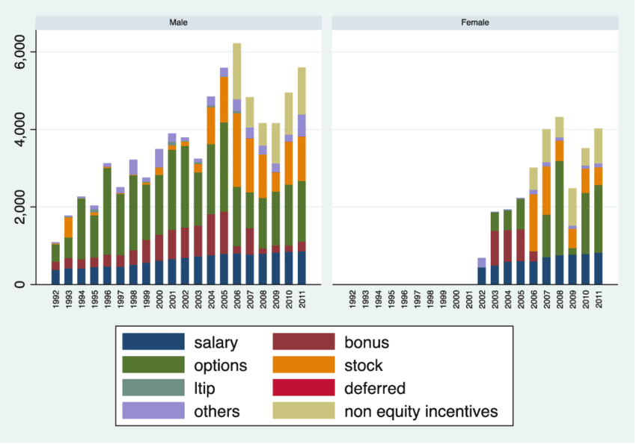
Average CEO compensation by gender in the hospitality industry (in thousands of USD)
Notes:
https://www.researchgate.net/figure/Average-CEO-compensation-by-gender-in-the-hospitality-industry-in-thousands-of-USD_fig1_334113553
In Sowon Kim, Giuliano Bianchi, Maria José Bosch (2020). An Examination of the Impact of Macro Context on Women CEOs in the Hospitality Industry. // in The New Ideal Worker (pp.251-265). researchgate.net/publication/334113553_An_Examination_of_the_Impact_of_Macro_Context_on_Women_CEOs_in_the_Hospitality_Industry

Slide 10
Paātrināt sieviešu attīstību
Pētījumi rāda:
Sievietes vadītājas palielina organizāciju sociālo veiktspēju
Sievietes vadītājas ir mazāk pašpārliecinātas nekā vīrieši, un šī īpašība pozitīvi izpaužas krīzes laikā
Sieviešu ekonomiskā līdzdalība un vadošā loma ir būtiska, lai veicinātu uzņēmējdarbības rezultātus un panāktu dzimumu līdzsvaru uzņēmumu valdēs
Notes:
https://www.researchgate.net/publication/334113553_An_Examination_of_the_Impact_of_Macro_Context_on_Women_CEOs_in_the_Hospitality_Industry
Female CEOs increase the social performance of organizations (Jalbert et al. 2013).
Women CEOs are less overconfident than men (Huang and Kisgen 2013), which is a trait that is positively associated with a crisis (Ho et al. 2016; Kim et al. 2016).(p. 254)
https://www.catalyst.org/research/women-leadership-sp-tsx/
Women’s economic participation and leadership are essential to driving business performance and achieving gender balance on corporate boards
Key Findings:
Companies in the S&P/ TSX Composite Index have made progress for women on boards: In 2019, women comprised 27.6% of board directors, vs. 18.3% in 2015.
There is more work to be done, however, to advance progress for women on executive teams. From 2015 to 2019, the percentage of women on executive teams among S&P/ TSX Composite Index companies increased only from 15.0% to 17.9%.
As of August 2019—for the first time in its history—every company in the S&P/ TSX Composite Index had at least one woman on its board.
GenDiv book (SIF)

Slide 11
General overview
3.nodaļa
1st Module consists of 2 Units
Unit 1: History of the labour market and gender inequalities in the workplace
The history of the development of the labor market, its definitions, the gradual involvement and participation of women in the labor market are reviewed.
Unit 2: Gender-specific characteristics at management level, micro- and power political dynamics in the organization
Stereotipu, aizspriedumu un klišeju definīcija un diferencēšana

Slide 12
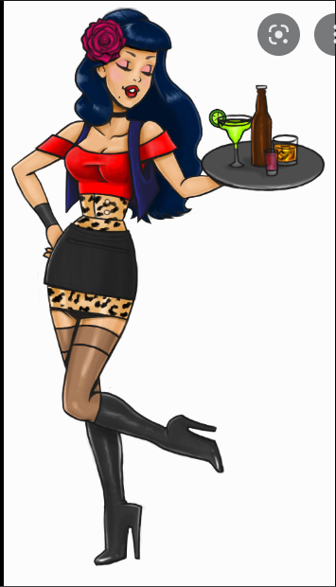
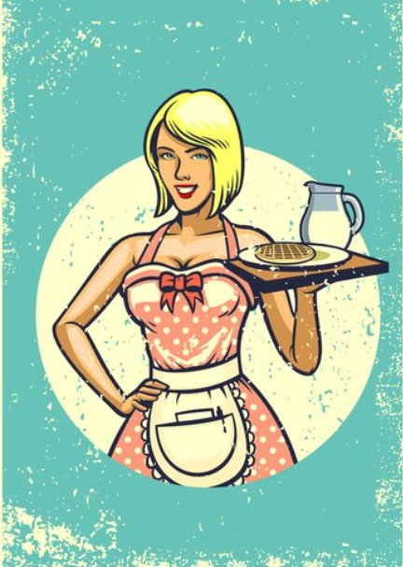
STEREOTIPI
Oficiante
Stereotips ir domas, kas kādam ir izveidojušās par konkrētiem indivīdu tipiem, un tās var gan precīzi atspoguļot, gan arī neatspoguļot realitāti.
Stereotipus var arī uzskatīt par karikatūrām, tas ir - attēliem, kuros ir pārspīlētas noteiktas iezīmes.
Pavārs

Slide 13
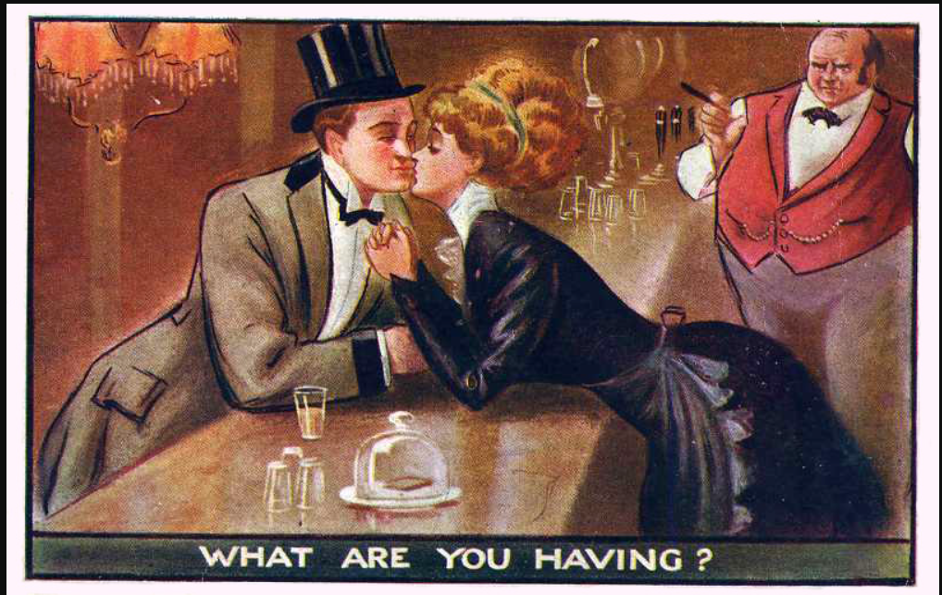
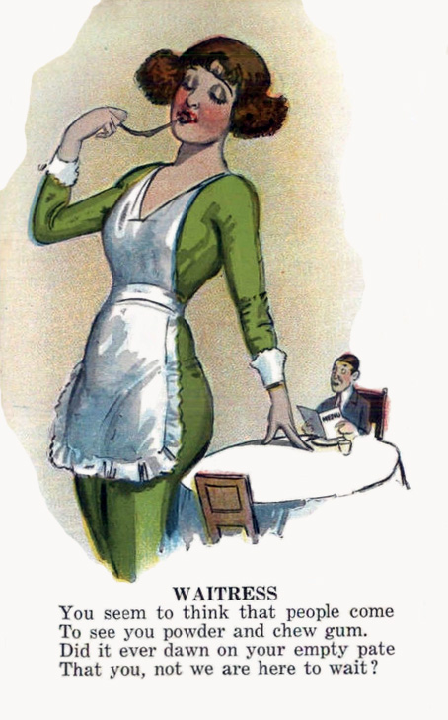
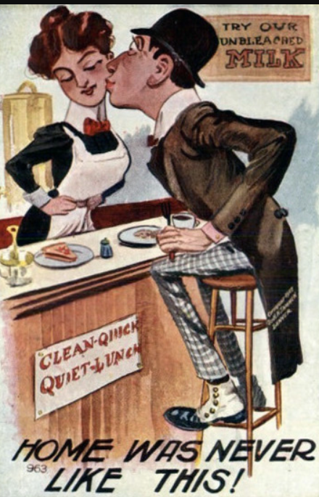
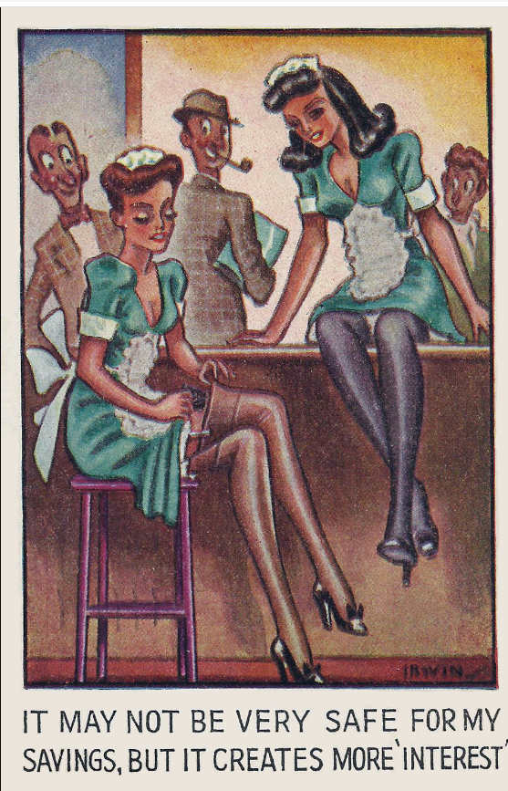
Stereotipi pagātnē
Attēli laikā no 1906. līdz 1915.gadam
Gandrīz visās joku atklātnēs humora avots bija citu cilvēku - sieviešu, melnādaino, imigrantu vai nabadzīgo - aizvainošana. Vairākās atklātnēs ilustrētās sievietes ir īru imigrantes, kas parasti tika attēlotas kā muļķīgas un neglītas.
Notes:
Restaurant-ing through history / Image gallery: insulting waitresses
https://restaurant-ingthroughhistory.com/tag/immigrant-waitresses/
Judging from postcards and cartoons, the early 20th century was not a fun time to be a waitress. However hard working, competent, or skilled in dealing with demanding situations they may have been [see recent op-ed on how much skill serving takes], there was no recognition of that in popular images.
Quite the contrary. The images were of two basic types. Either female servers were shown as incompetent or as objects of fantasy who were open to the sexual advances of their customers.
All but two of these images in this post are from 1906 to about 1915. The gum chewer is from the 1920s.
The reasons for these degrading images could be many. Joke-style postcards were designed to get men to send postcards, an activity that they were less inclined to do than were women. Almost all joke postcards derived humor from insulting others, whether women, Blacks, immigrants, or the poor. On several of the cards in the post, the women illustrated are Irish immigrants, a status that was generally portrayed as both stupid and ugly. Women who were in the public eye, such as actresses, department store clerks, or restaurant workers, were evidently considered fair game, possibly out of resentment that they strayed outside the realm of church and home or because they appeared in public without male protection.
Later postcards mostly dropped the theme of incompetence but images of sexy bimbo waitresses persisted for decades, as for example on this postcard mailed in 1946.

Slide 14
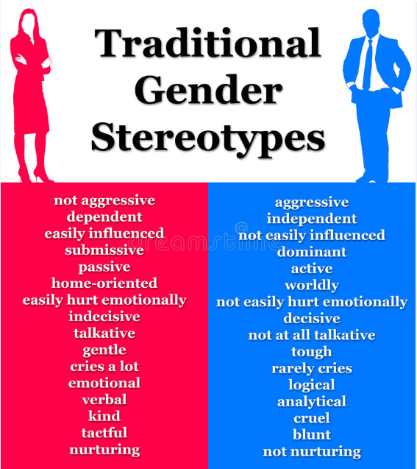

Slide 15
KLIŠEJAS un AIZSPRIEDUMI
Klišejas ir termini, frāzes vai pat idejas, kas to rašanās brīdī varēja būt interesantas un rosinošas, bet atkārtošanās un to pārmērīgas lietošanas dēļ kļuva neoriģinālas.
Aizspriedumi ir viedoklis, kas bieži vien ir nelabvēlīgs, un kas ir izveidots, pirms ir iegūti uz saprātu vai pieredzi balstīti pierādījumi.
Notes:
Origin of the Word Cliché
The word cliché has French origins, which is why you'll often see it with an accent over the "e," but you can also write it as "cliche" in English. When printing presses were used, the cast iron plate that reproduced the words, phrases, or images was called a stereotype. The noise that casting plate made sounded like “cliché,” meaning click, to French printers, so this onomatopoeia word became printer’s jargon for the stereotype. Thus, cliché came to mean a word or phrase that gets repeated often.
Just because a phrase is overused doesn't mean it's a cliché, and because a phrase is a cliché doesn't mean it isn't true. A cliché conveys an idea or message but loses its point through over-usage. We'll let you be the judge of these examples of clichés you'll find in everyday use.

Slide 16
Mikro- un varas politika organizācijās
4.NODAĻA

Slide 17
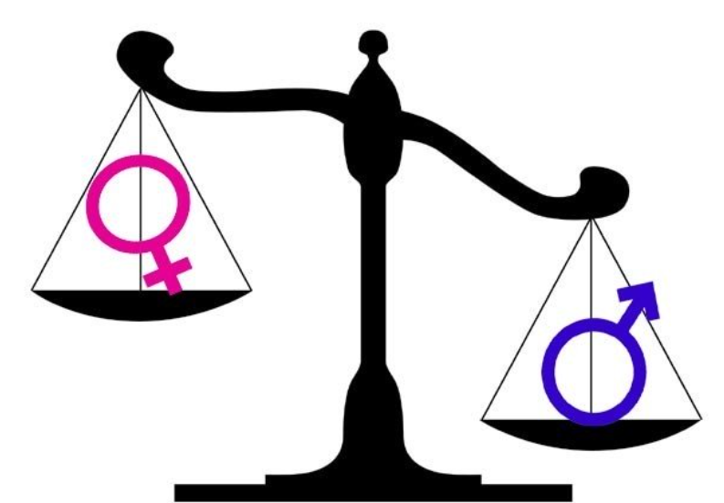
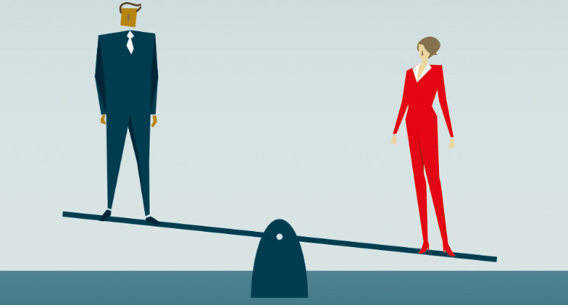
Mikro- un varas politika organizācijās
Dominējošo dzimumu normu pamatā ir nevienlīdzīgi priekšstati par statusu un varas atšķirībām;
To vēl vairāk pastiprina citu atšķirību ietekme, radot pamatu vardarbības leģitimizēšanai.
Bieži vien vīriešu un sieviešu attiecībās valda varas nelīdzsvarotība, ko izraisa dzimuma, sociālo un kultūras faktoru, kā arī individuālu bērnības ievainojumu kombinācija.
Notes:
Gender matters: Rethinking violence in tourism. Annals of Tourism Research, J o u r n a l h o m e p a g e : h t t p s : / / w w w . j o u r n a l s . e l s e v i e r . c o m / a n n a l s - o f -t o u r i s m - r e s e a r c h https://www.sciencedirect.com/science/article/pii/S0160738321000050#bbb0075
Harvard Business Review, Power and Politics in Organizational Life
https://hbr.org/1970/05/power-and-politics-in-organizational-life

Slide 18
Tūrisma reklāmas specifika
Tūrisma reklāmās sievietes bieži tiek attēlotas kā seksa objekti vīriešiem
Vardarbība un uzmākšanās - seksuāla vai morāla - rodas darbavietās, kur dominē nevienlīdzīgas varas attiecības, kā arī tur, kur pastāv trūkumi darba organizācijā un vadībā un uzņēmuma kultūru ir iedragājušas sliktas savstarpējās attiecības.
Tūrisma nozarē pastāv arī ietekmes un pretestība, kas izaicina stereotipiskus priekšstatus par sievišķību un vīrišķību
Notes:
Annals of Tourism Research, Volume 88, May 2021, 103143
Gender matters: Rethinking violence in tourism (https://www.sciencedirect.com/science/article/pii/S0160738321000050)

Slide 19
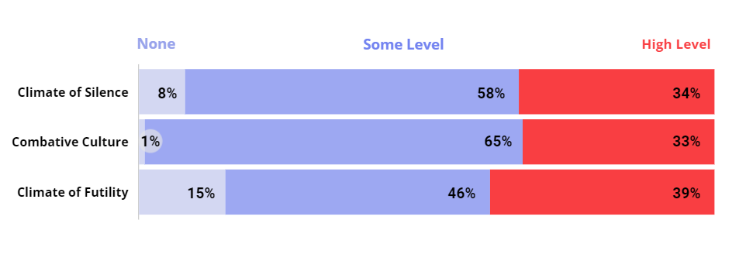
Negatīvs organizācijas klimats ir spēcīgs šķērslis seksisma pārtraukšanai
Bieži ir sastopama šo trīs negatīvo apstākļu augsta koncentrācija.
Notes:
Climate of Silence: An environment where employees feel restrained from constructively speaking up about organizational or work-related problems, concerns, or challenges.
Combative Culture: A hyper-competitive workplace culture in which value is placed on four dimensions: show no weakness, display strength and stamina, put work first, and act as if it’s a dog-eat-dog world.
Climate of Futility: The sense that efforts to make change are not welcome and will not have the desired
‹#›

Slide 20
Kā organizācijas var iedrošināt vīriešus pārtraukt seksismu, 2022.gada ziņojums
NE VISI VĪRIEŠI IEJAUCAS, KAD REDZ VAI DZIRD SEKSISTISKUS KOMENTĀRUS DARBAVIETĀ
Darbības, ko organizācijas var veikt, lai iesaistītu vīriešus cīņā pret seksismu darbavietā:
Risiniet sistēmiskas problēmas, kas darba vietā uztur vidi, kurā netiek runāts par problēmām, naidīgu kultūru un veicina bezjēdzības gaisotni.
Apšaubiet stingrus vīrišķības standartus un risiniet sistēmiskas problēmas, kas palielina vīriešu trauksmi darba vietā.
Radiet vidi, kurā vadītāji ir atvērti un darbinieki jūtas uzklausīti.
Notes:
WORKPLACES THAT WORK FOR WOMEN, 60 YEARS CATALYST
https://www.catalyst.org/research/workplace-sexism-climates/
As sexism against women in the workplace persists globally, many men want to be part of the solution. They have several advantages: Men hold most positions of power in organizations; they face fewer costs than women do when challenging other men for being sexist; and their responses to sexist comments are more likely to be considered than if they came from a woman.
However, we know that not all men intervene when they see or hear sexist comments in the workplace—and that in many situations, even men committed to combatting sexism against women may do nothing in response to a sexist act.
What can organizations do to help men become better partners in the struggle against workplace sexism?
Interrupting Sexism at Work, Catalyst’s global research series on the organizational conditions that encourage or discourage men from responding when they witness incidences of sexism at work, sought to answer this question.
Through studies in 12 countries across three global regions, we found three major actions organizations can take to engage more men in combatting workplace sexism:
Address systemic issues that perpetuate a climate of silence, a combative culture, and a climate of futility in the workplace. Data show that a large portion of men’s intent to do nothing in response to a sexist comment can be attributed to these three negative organizational conditions.
Challenge rigid standards of masculinity and address systemic issues that increase masculine anxiety among men in the workplace. Data show a direct link between masculine anxiety and men’s intent to do nothing. Masculine anxiety also boosts the link between a combative culture and doing nothing.
Create an environment where managers are open and employees feel heard. Data show a link between manager openness and men’s intent to directly interrupt sexism. Manager openness can also improve employee feelings of being heard, which is also linked to men’s intent to directly interrupt sexism.
‹#›

Slide 21
SPĒKA DINAMIKA UN VARA
Politika ir prakse, kas ļauj efektīvi orientēties cilvēku sistēmā. Organizācijas ir cilvēku sistēmas. Vara organizācijā ir ietekmes un prioritāšu plūsma organizācijā. Vara rodas no enerģijas.
Bieži sastopamie varas avoti ir autoritāte, ekonomika vai personība..
Vara var būt slēpta un neformāla, tā ne vienmēr atbilst organizatoriskajai hierarhijai. Kā piemēru var minēt administratīvo asistentu, kurš nosaka to, ko dzird un redz izpilddirektors.
Transformējoša vadība ir politiska loma orgnizācijā.
Līderi - pārmaiņu aģenti.
Notes:
Formal power comes from the official position one holds within an organization or social structure. It is properly recognized by some type of written contract or official agreement, and regulated by a strict set of rules that everyone in the organization or social structure knows and must obey.
Formal forms of power exist in politics, business, religion, but also in social structures like a sports team or a student’s club. The manager of a company has formal power. So does the captain of a football team. This type of power changes as one’s official position within a structure changes, which is why many people compulsively seek to better their position.

Slide 22
Formālā un neformālā vara
Formālā vara izriet no oficiālā amata, ko cilvēks ieņem organizācijā vai sociālajā struktūrā.
Neformālā vara rodas nevis no oficiāla amata, bet gan no cieņas un atzinības, ko cilvēks ir iemantojis grupas biedru vidū. Šī cieņa un atzinība ļauj indivīdam ietekmēt savus kolēģus tā, kā citi grupas biedri to nevar izdarīt.
I. Neformāla vara - atzīts kā ļoti kompetents un prasmīgs savā darbā;
Vai/un
II. Neformāla vara - simpātisks un harizmātisks.
Notes:
Formal power comes from the official position one holds within an organization or social structure. It is properly recognized by some type of written contract or official agreement, and regulated by a strict set of rules that everyone in the organization or social structure knows and must obey.
Formal forms of power exist in politics, business, religion, but also in social structures like a sports team or a student’s club. The manager of a company has formal power. So does the captain of a football team. This type of power changes as one’s official position within a structure changes, which is why many people compulsively seek to better their position.

Slide 23
Praktiski piemēri
Izveidojiet 3-4 cilvēku grupu. Apspriediet apgalvojumus, pa vienam katrā grupā, par to, kā jūsu organizācijām veicas un ko varētu darīt šajā jomā.
Kāda šeit ir organizācijas formālo un neformālo vadītāju loma?
(10 min.)
Risiniet sistēmiskas problēmas, kas darba vietā rada klusuma atmosfēru, cīņas kultūru un bezjēdzības gaisotni.
Apstrīdēt stingrus vīrišķības standartus un risināt sistēmiskus jautājumus, kas palielina vīriešu trauksmi darba vietā.
Radiet vidi, kurā vadītāji ir atvērti un darbinieki jūtas uzklausīti.

Slide 24
Atsauces :
Sowon Kim, Giuliano Bianchi, Maria José Bosch (2020). An Examination of the Impact of Macro Context on Women CEOs in the Hospitality Industry. // in The New Ideal Worker (pp.251-265). https://www.researchgate.net/publication/334113553_An_Examination_of_the_Impact_of_Macro_Context_on_Women_CEOs_in_the_Hospitality_Industry
Hinchliffe, E. (2021). The number of women running Global 500 businesses soars to an all-time high. Fortune.
Gender matters: Rethinking violence in tourism. Annals of Tourism Research, J o u r n a l h o m e p a g e : h t t p s : / / w w w . j o u r n a l s . e l s e v i e r . c o m / a n n a l s - o f -t o u r i s m - r e s e a r c h https://www.sciencedirect.com/science/article/pii/S0160738321000050#bbb0075
Harvard Business Review, Power and Politics in Organizational Life (https://hbr.org/1970/05/power-and-politics-in-organizational-life)
Annals of Tourism Research, Volume 88, May 2021, Gender matters: Rethinking violence in tourism (https://www.sciencedirect.com/science/article/pii/S0160738321000050)
WORKPLACES THAT WORK FOR WOMEN, 60 years Catalyst (https://www.catalyst.org/research/workplace-sexism-climates/)
Protecting migrant workers from exploitation in the EU: workers’ perspectives
(https://fra.europa.eu/sites/default/files/fra_uploads/fra-2019-severe-labour-exploitation-workers-perspectives_en.pdf)
Same job, different income: withdrawing EU migrants’ benefits would violate an EU founding principle
(https://blogs.lse.ac.uk/brexit/2015/11/17/in-work-benefits-for-migrants-digging-a-hole/)

Slide 25
Atsauces :
TOURISM’S DIRTY SECRET: THE EXPLOITATION OF HOTEL HOUSEKEEPERS: oxfam canada report. (https://oxfamilibrary.openrepository.com/bitstream/handle/10546/620355/rr-tourisms-dirty-secret- 171017-en.pdf%3Bjsessionid=793604C2A572759E16008BC94B70C503?sequence=1)
https://www.catalyst.org/research/women-in-management/

Slide 26
Paldies par uzmanību

Slide 27
Projekta partneri
DEKAPLUS
Cyprus
Czech University of Life Sciences Prague Czech Republic
DIAS Greece
OUT LOUD
Latvia
Social Innovation Fund Lithuania
Pancyprian Association of Hotel Managers Cyprus
Beneke & Prinzhorn GmbH Germany
https://www.weedout.eu/

